Slide 1
Service oriented architecture

Slide 2
AGENDA
What is SOA
SOA Keypoints
Architecture
Implementation

Slide 3
What is soa

Slide 4
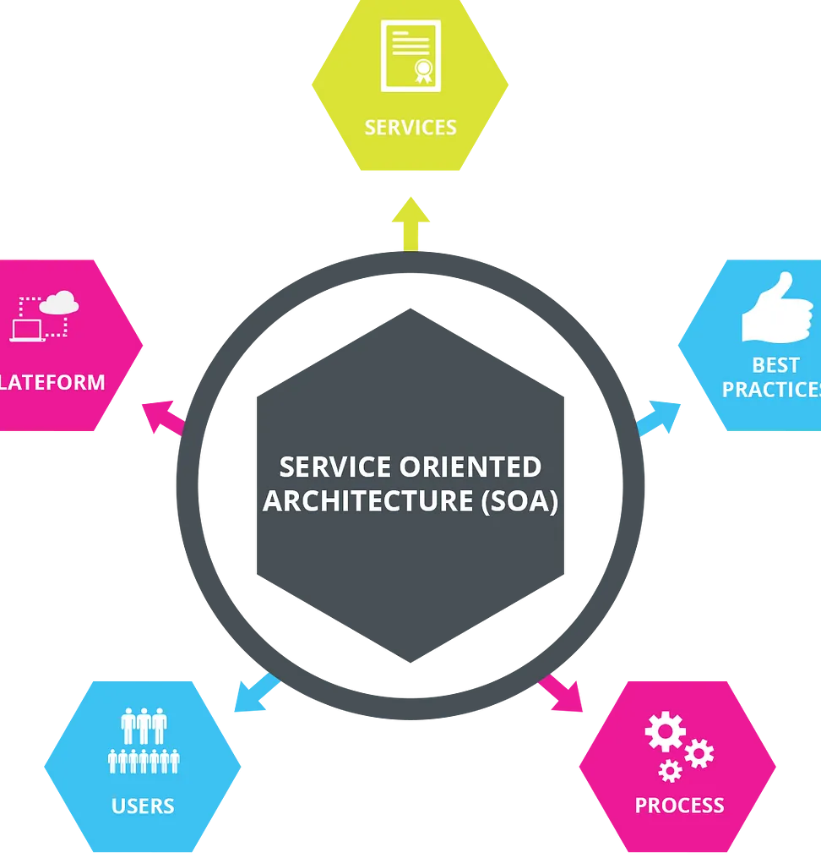
Service oriented architecture

Slide 5
Service oriented architecture
Modular Services
Breaks down software functionality into independent, reusable services
Each service performs a specific function and can be deployed separately

Slide 6
Service oriented architecture
Interoperability
Uses standardized communication protocols (e.g., HTTP, XML, SOAP, REST)
Ensures services work across various platforms and technologies

Slide 7
Service oriented architecture
Loose Coupling
Services interact with minimal dependencies
Facilitates easier modification, replacement, and scaling

Slide 8
Service oriented architecture
Service Contracts
Each service has a clear, formal contract (e.g., WSDL for SOAP, API specifications for REST)
Defines operations and input/output formats for client interactions

Slide 9
Service oriented architecture
Governance and Management
Includes practices for overseeing service creation, deployment, and maintenance
Ensures consistency, security, compliance, and resource efficiency

Slide 10
Implementation

Slide 11
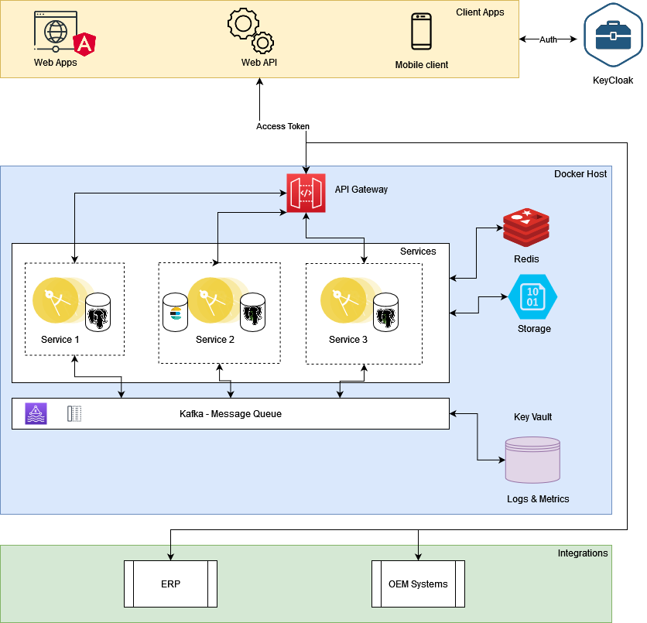
Architecture

Slide 12
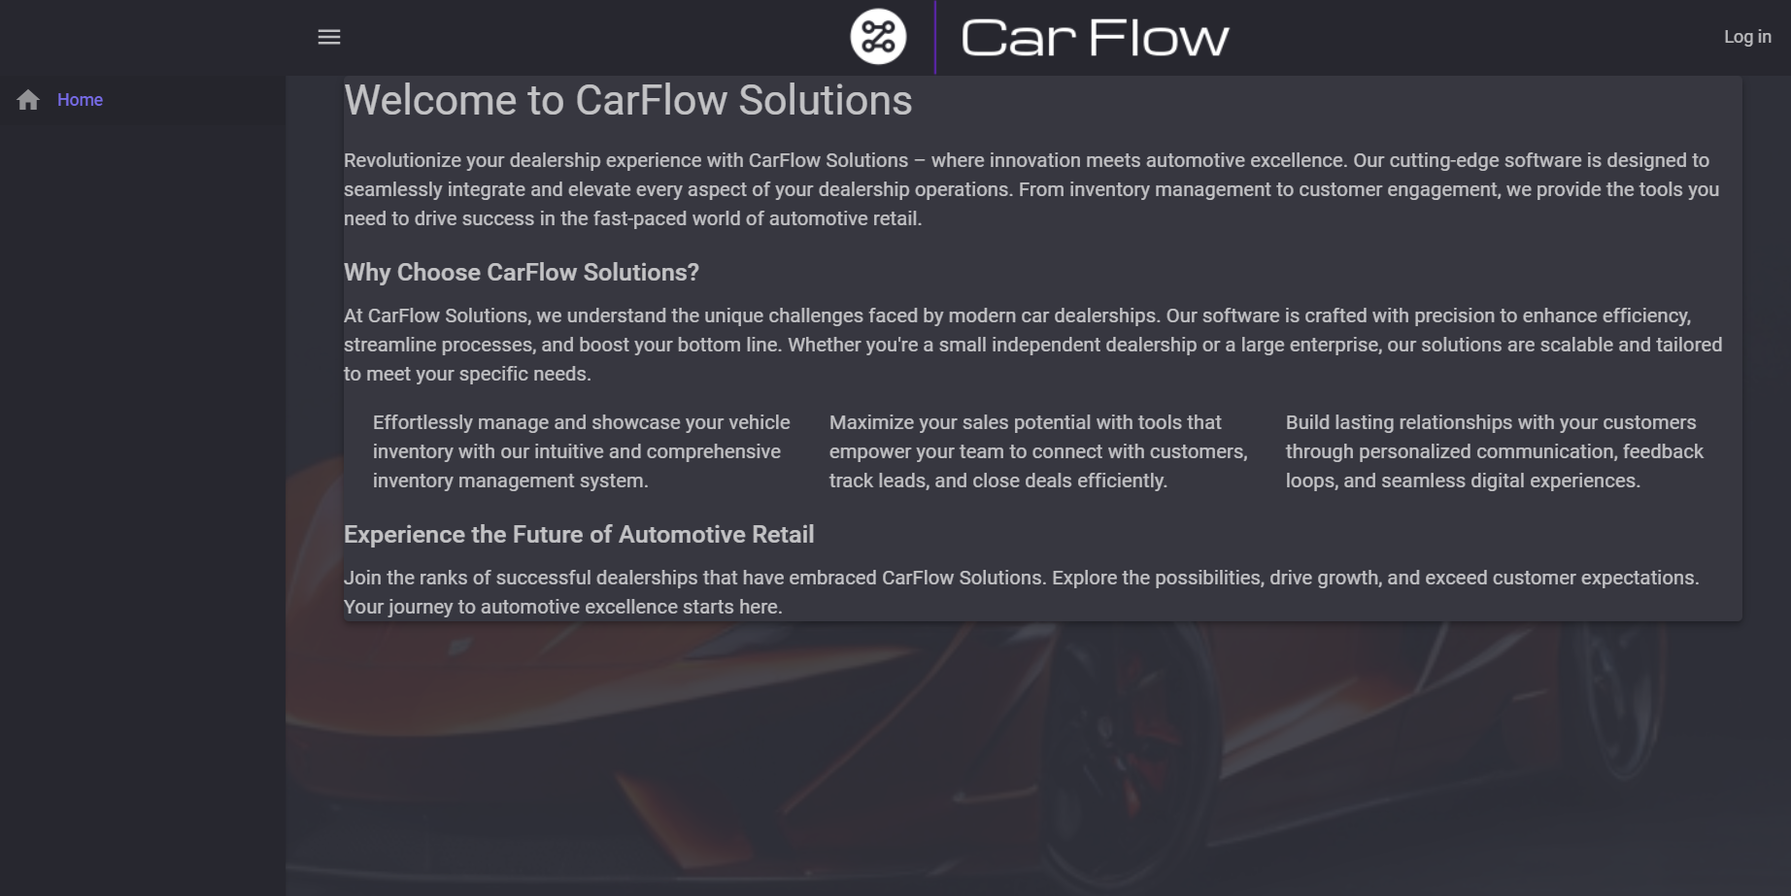
MAIN PAGE

Slide 13
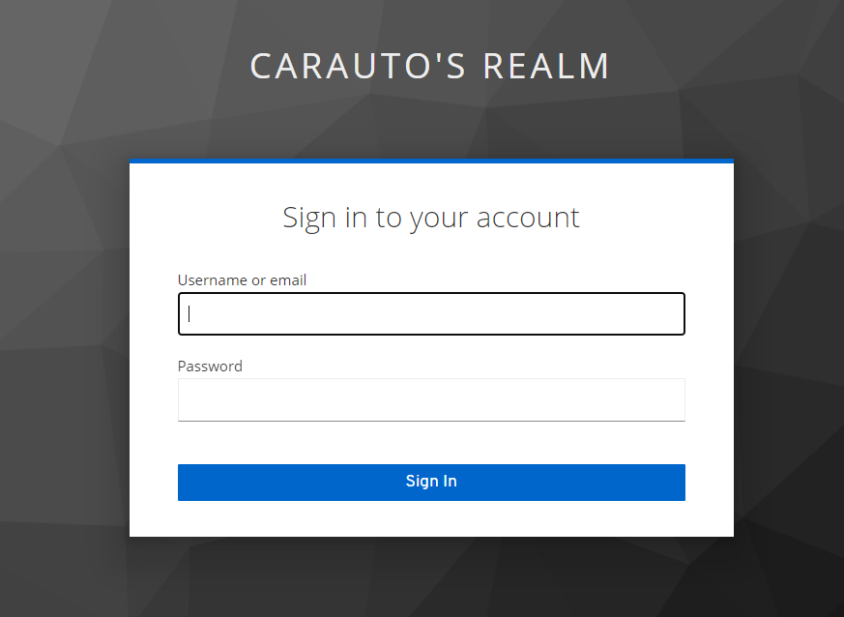
Login page

Slide 14
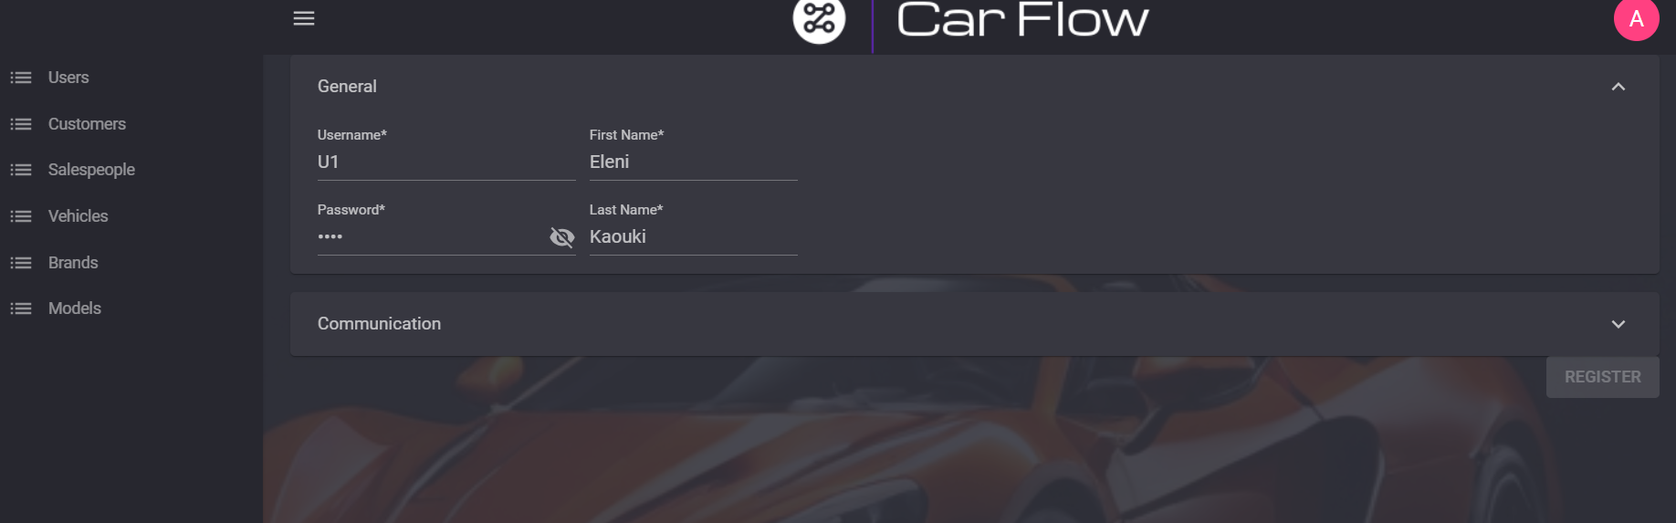
ADMINISTRATIVE PAGE

Slide 15
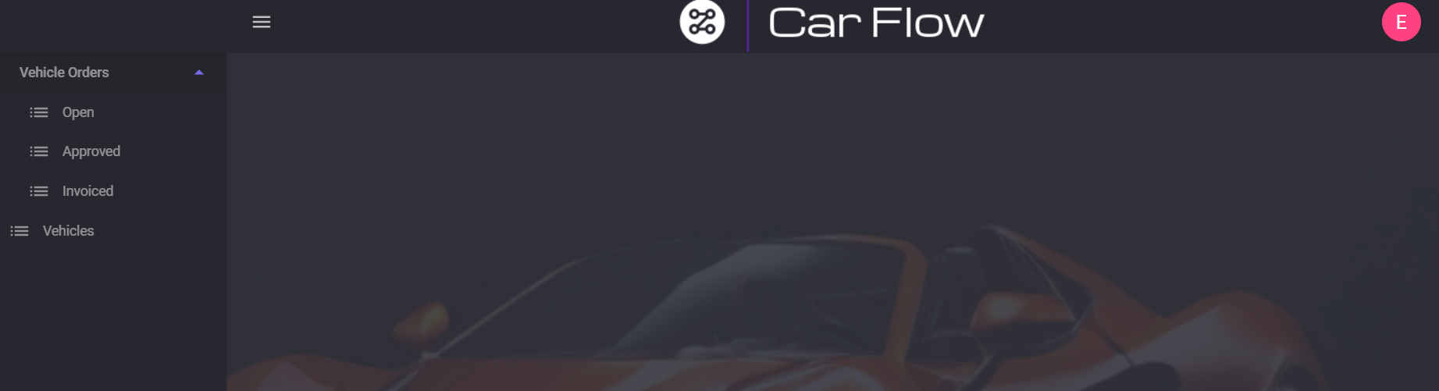
USER PAGE

Slide 16
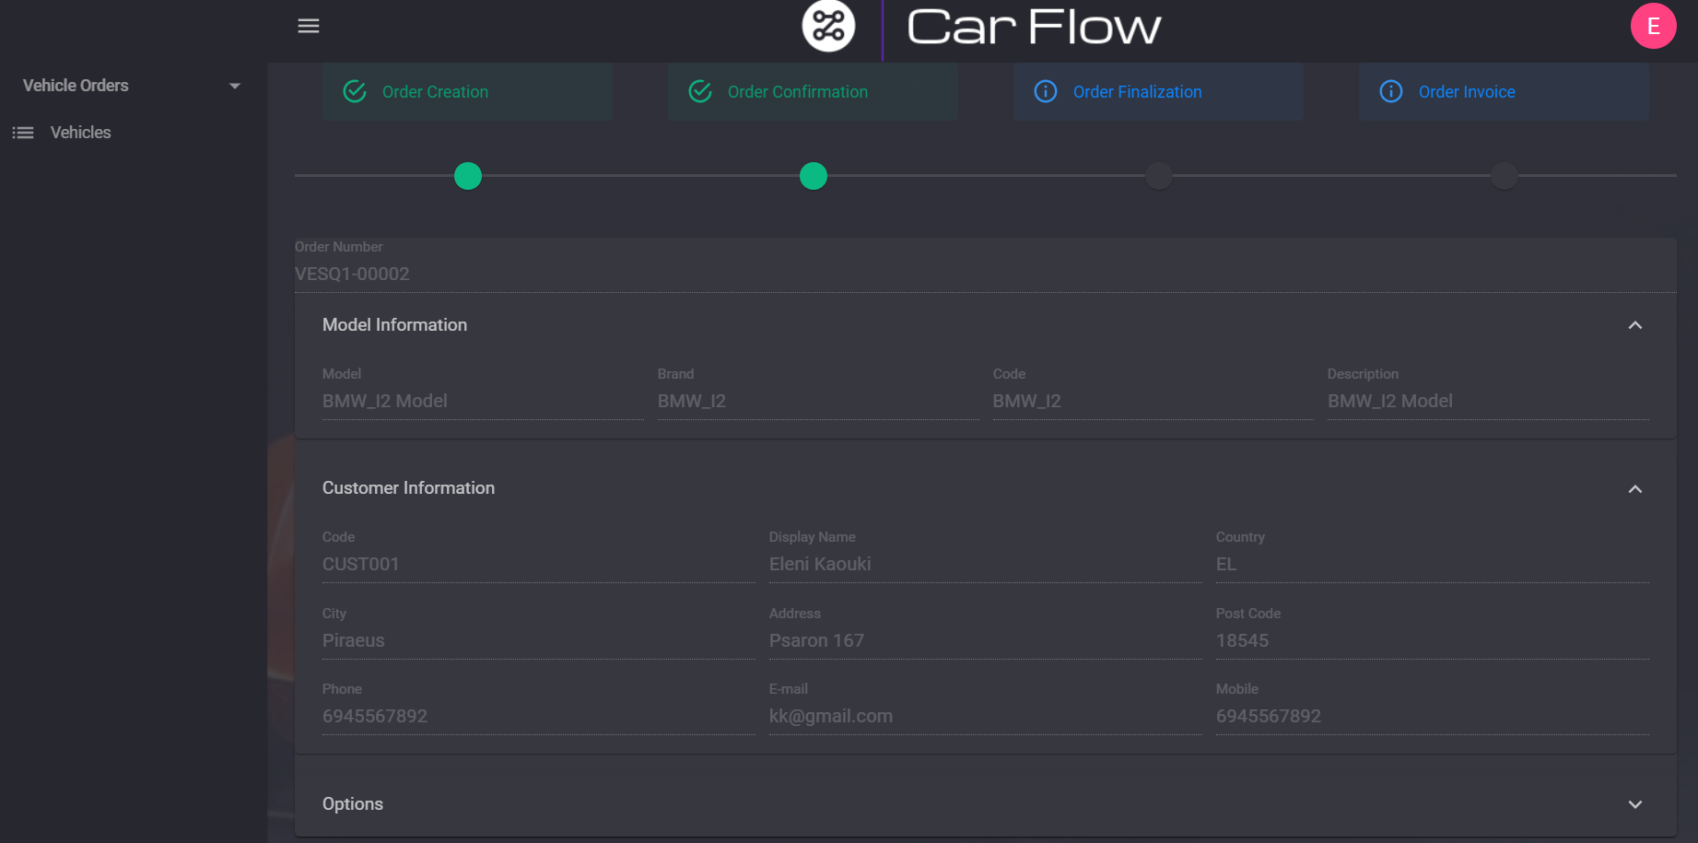
USER ORDER CREATION PAGE

Slide 17
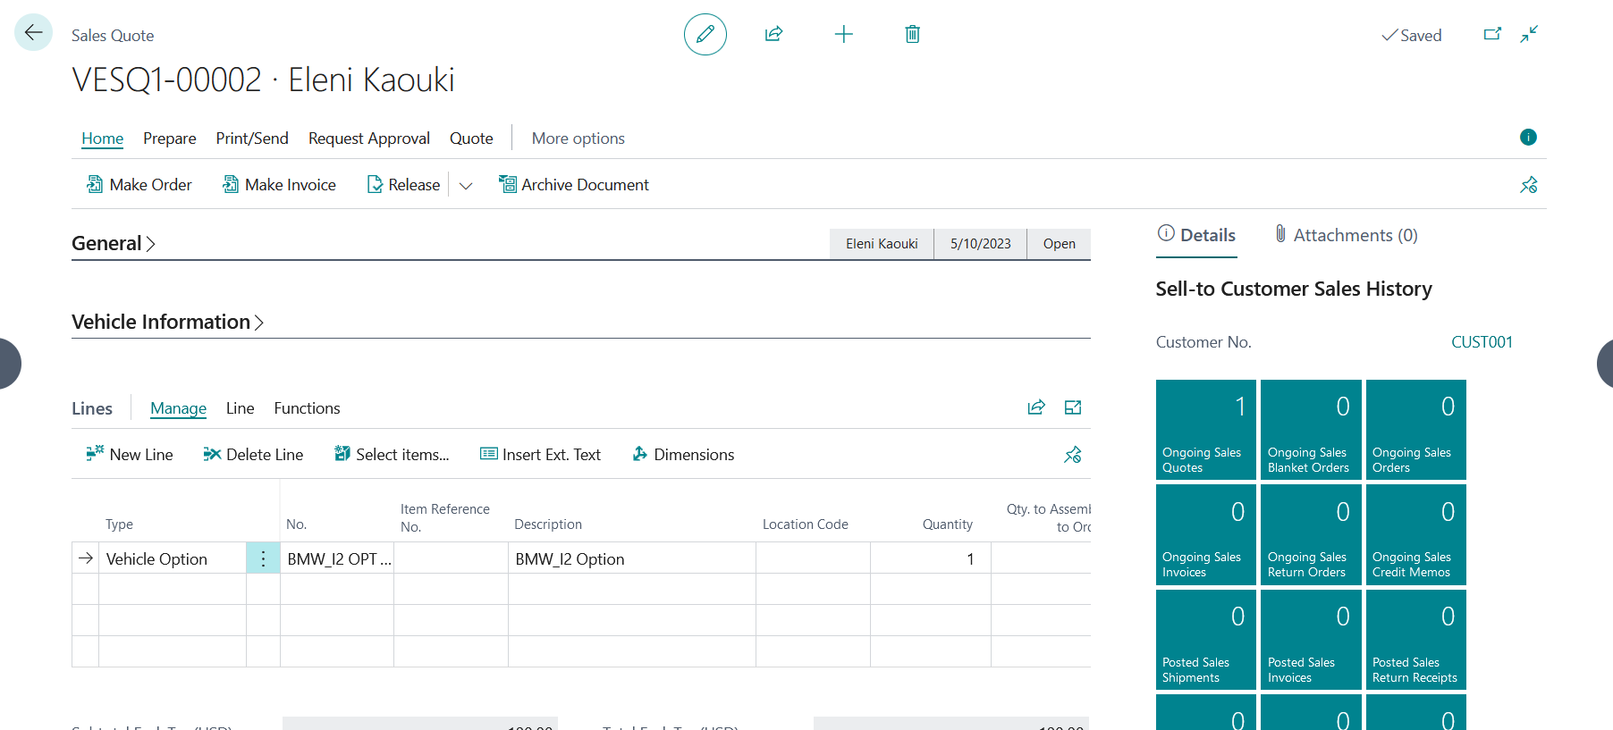
Quote delivery to erp

Slide 18
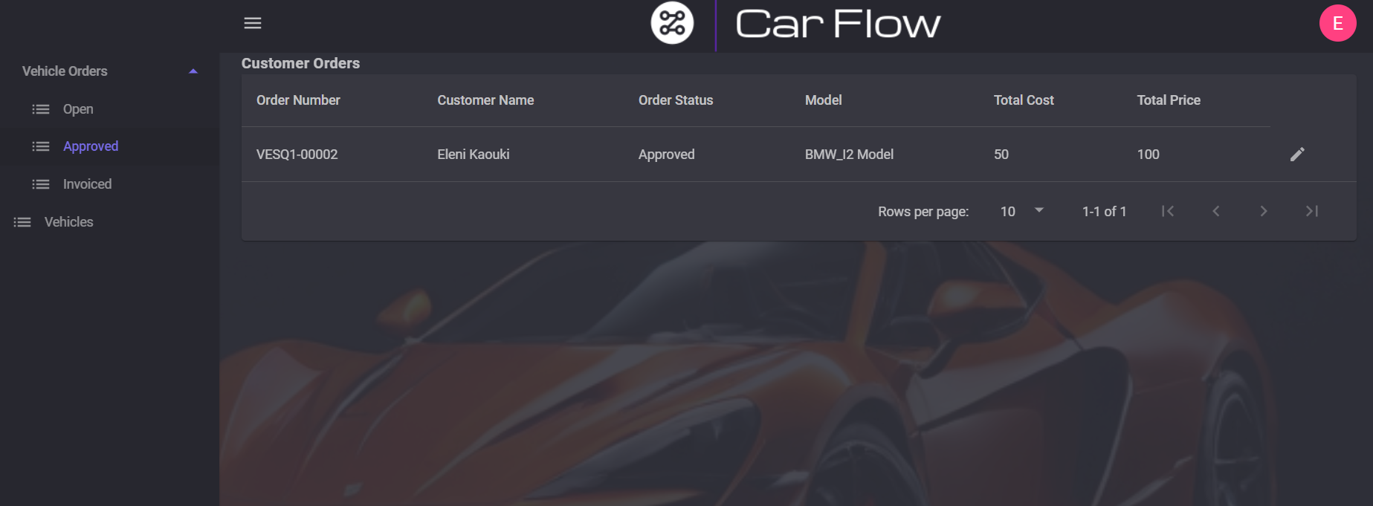
QUOTE TO ORDER (approved)

Slide 19
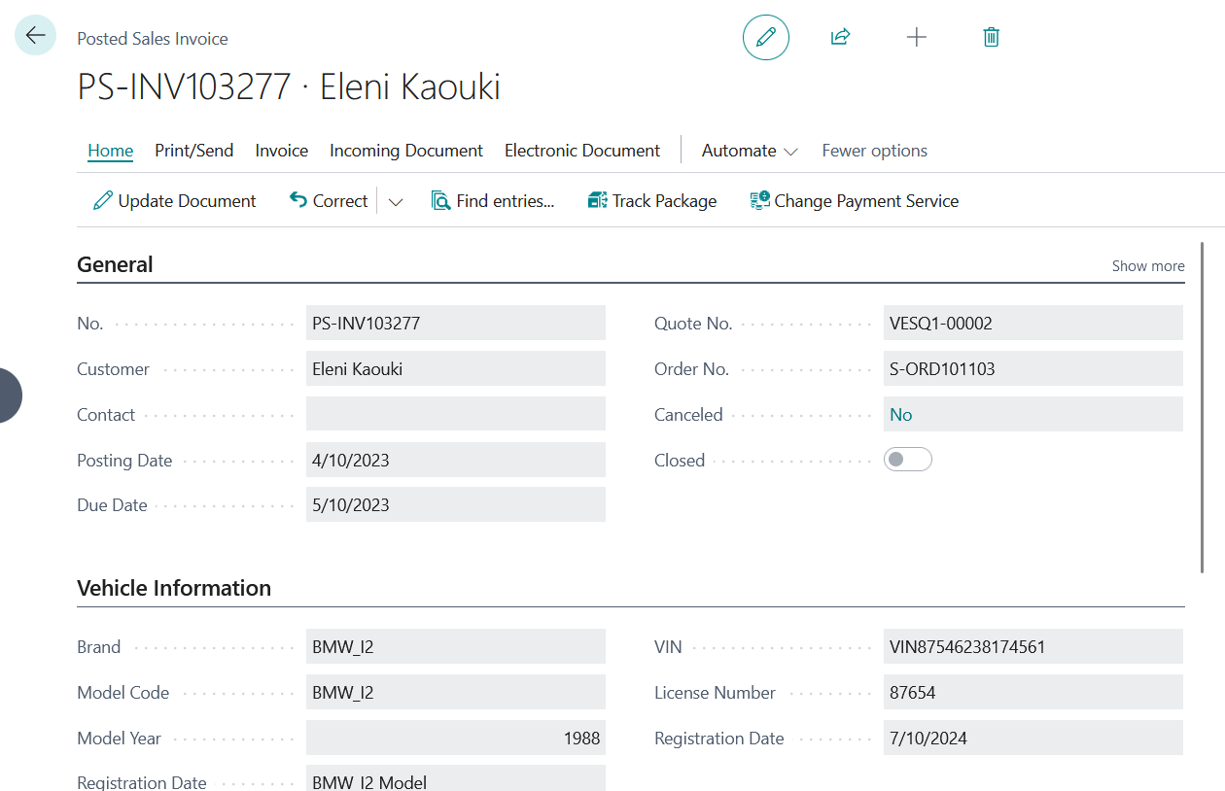
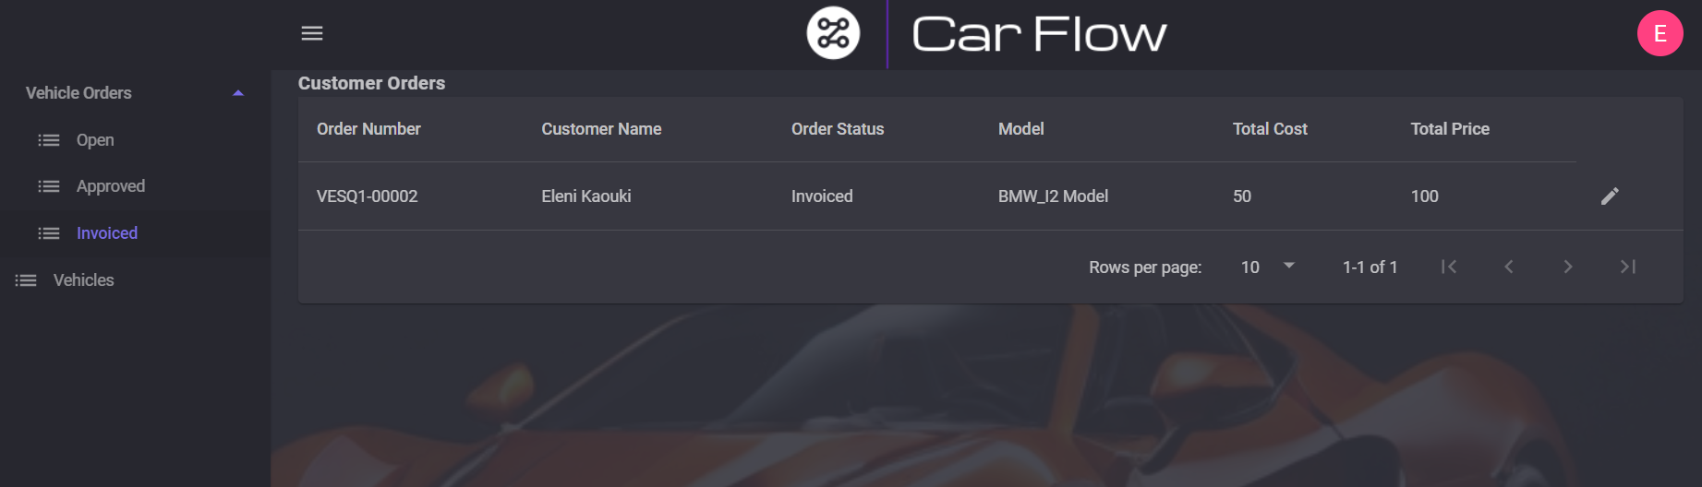
Posted invoice

Slide 20
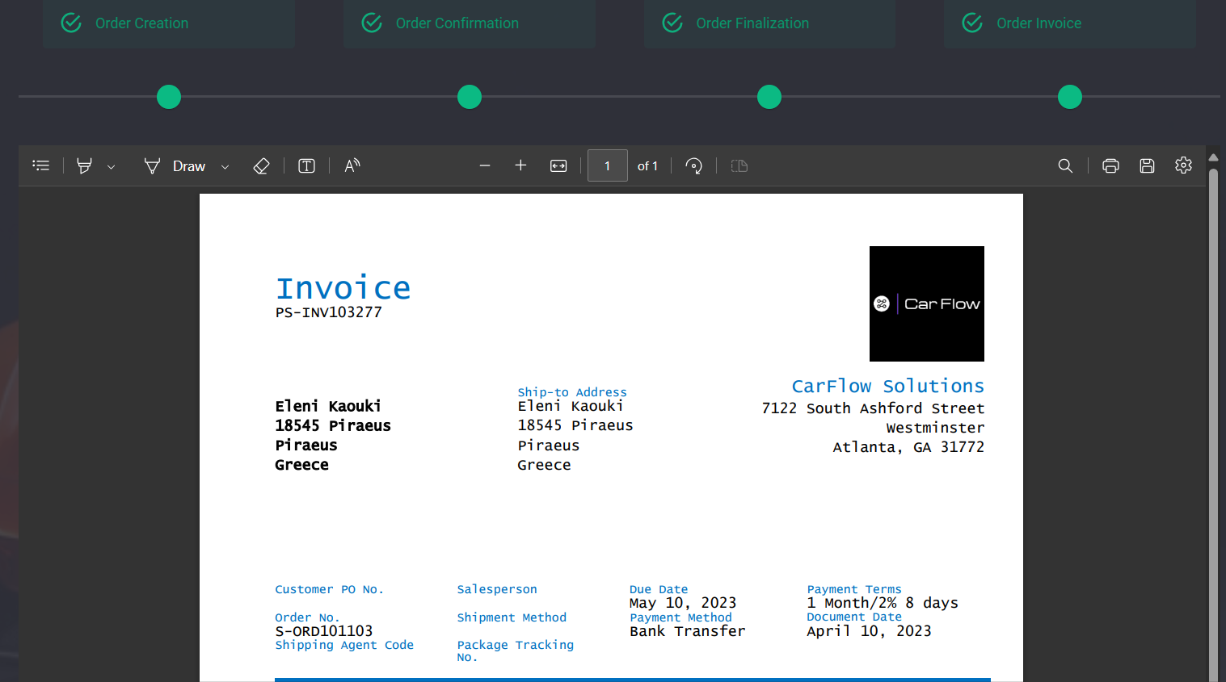
Posted invoice report

Slide 21

WORKFLOW
The workflow that we just saw included:
A setup of the User/Customer for the frontend system by the administrator.
Creation of a Quote in the frontend system.
Transfer of the Quote to the ERP
Processing in ERP
Flow step in frontend

Slide 22
THANK YOU
Stamatis Liatsos
PA06198
stamatisliatsos@outlook.com

